Slide 2
Disclaimer! I am not a professional!

Slide 3
New Kitchen: cost $42,000

Slide 4
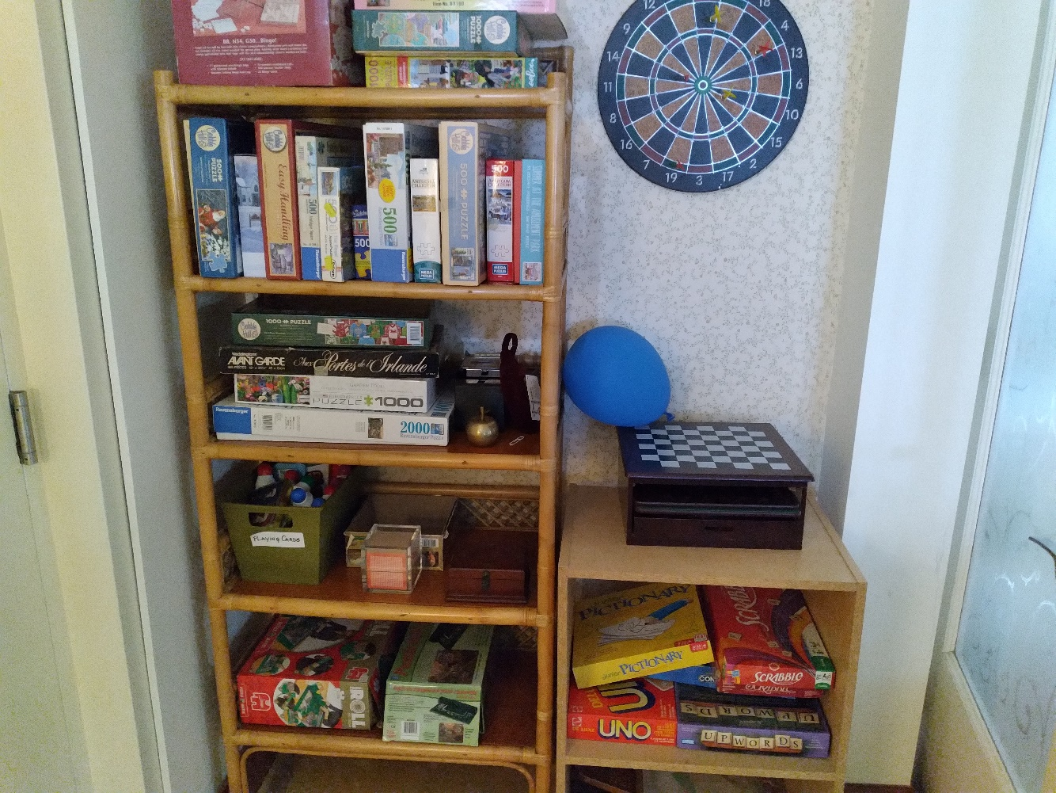
Arts and crafts, puzzles, games, books and exercise classes: $4400.

Slide 5
New breakfast room for residents: $11,000

Slide 6
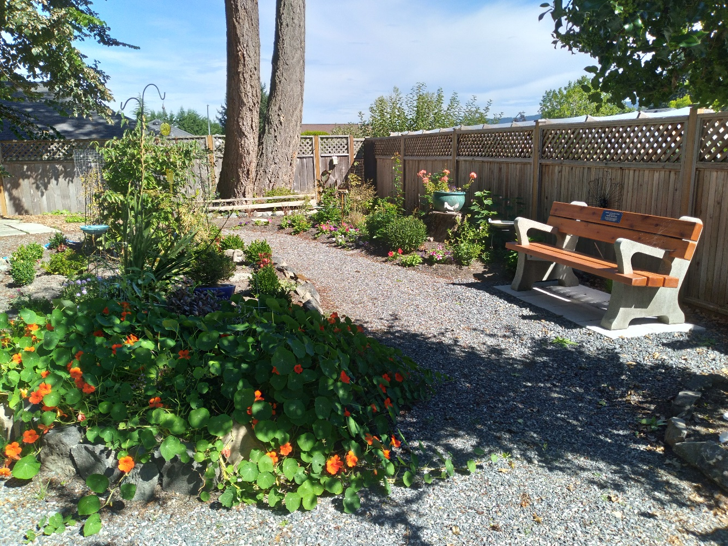
Memorial Garden: $8000

Slide 7
Stair Lift Project 2022: $20,000

Slide 10
Grant Advance Solutions
Pros
Large data base
Document generator
Budget templates
Tutorials
Tech support
Cons
Time consuming
Expensive
No guarantee of success

Slide 11
Monthly subscription: $85 Yearly subscription: $599

Slide 13
Government applications are so long!

Slide 14
Truth in Grant Writing: Fact or Fiction?
“I’m a fiction writer, in the grant writing genre”.

Slide 15
What do you include in your grant application?
Letter of introduction
Budget
Constitution and bylaws
Most recent financials
Estimates from contractors
Photos
Letter of support
Any other pertinent information

Slide 16
Where do you find grants?
The Victoria Foundation
The Rick Hansen Foundation
The Vancouver Foundation
Helpage Canada
Service groups
Seniors organizations
Businesses
Banks

Slide 17
What about Abbeyfield?!
The BC Trust Society
Abbeyfield Canada
Abbeyfield International

Slide 18
Grants in Canada

