Slide 1

Abbeyfield Team Pages
Presented by Rhonda Flanagan
Abbeyfield Canada Administration
rhondaf@abbefield.ca
www.Abbeyfield.ca
2022 Abbeyfield BC Chapter

Slide 2
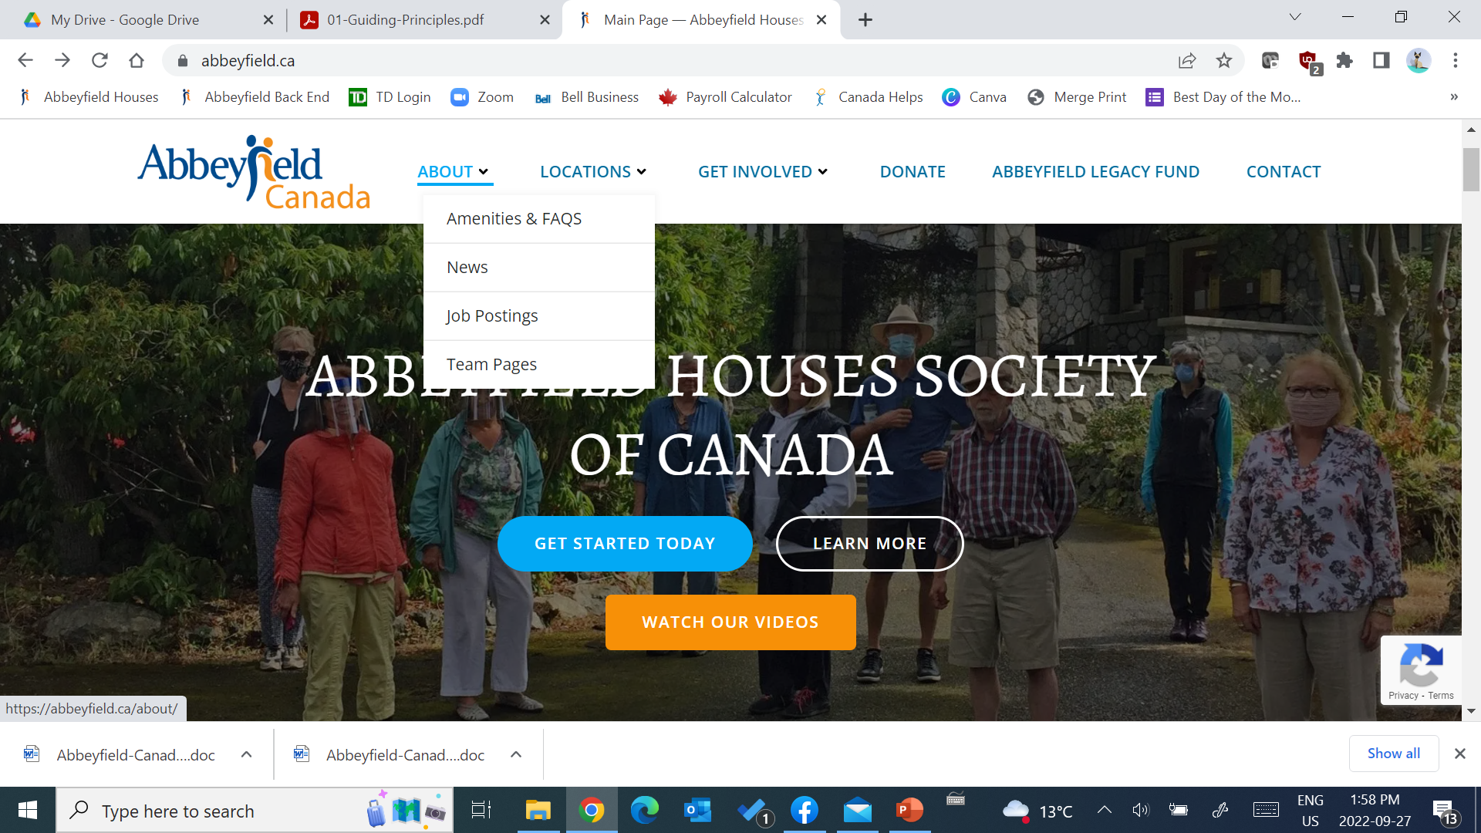

Slide 3
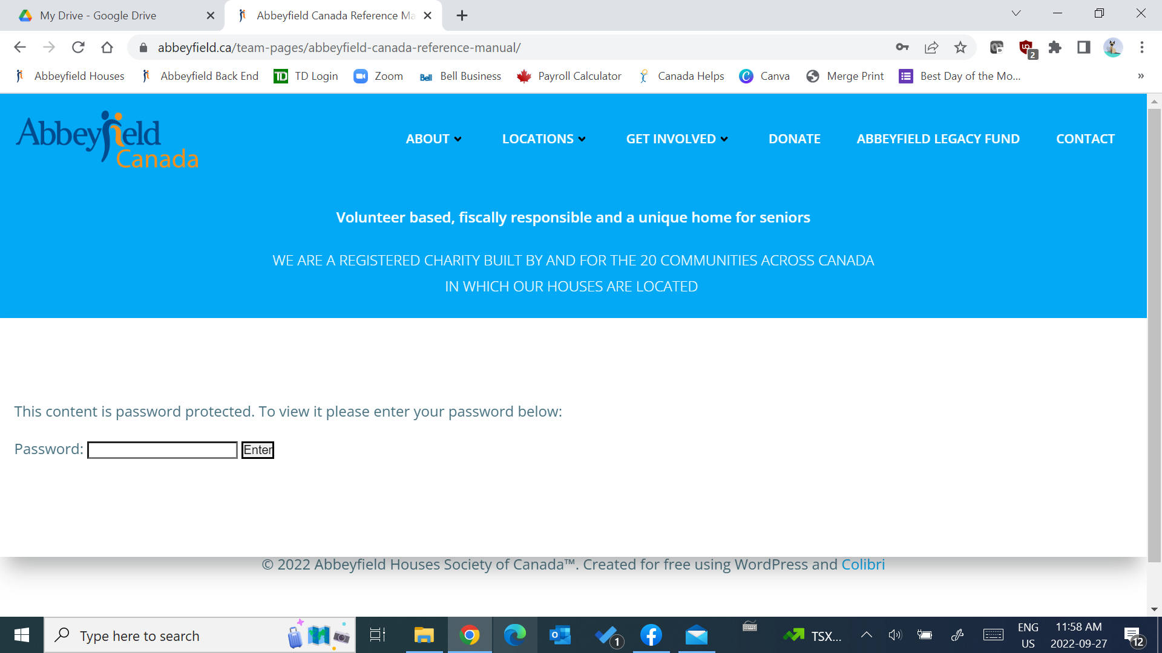

Slide 4
https://abbeyfield.ca/team-pages/
Today’ Password:
AbbeyField2021!

Slide 5
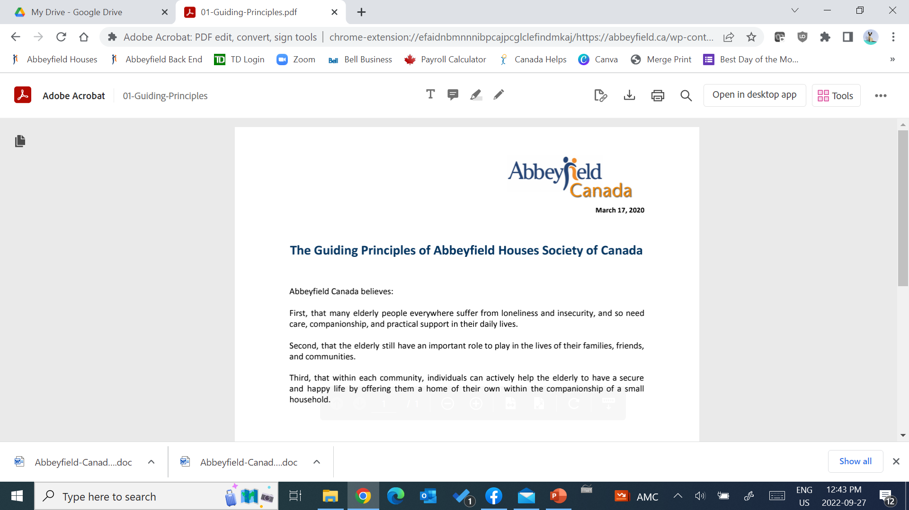

Slide 6
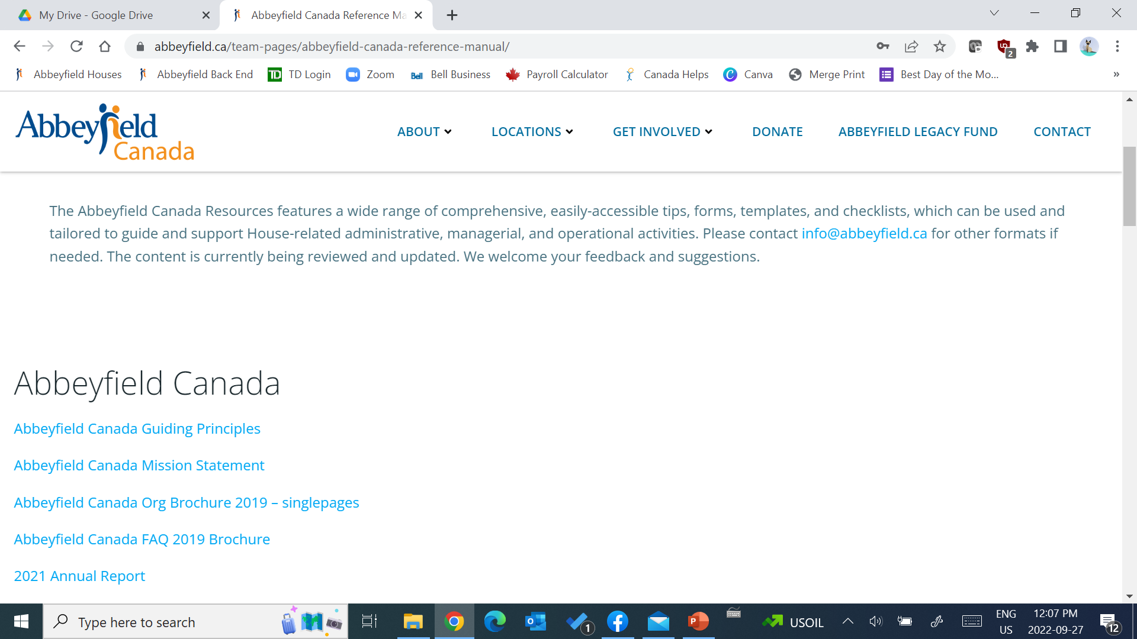
https://abbeyfield.ca/team-pages/abbeyfield-canada-reference-manual/

Slide 7
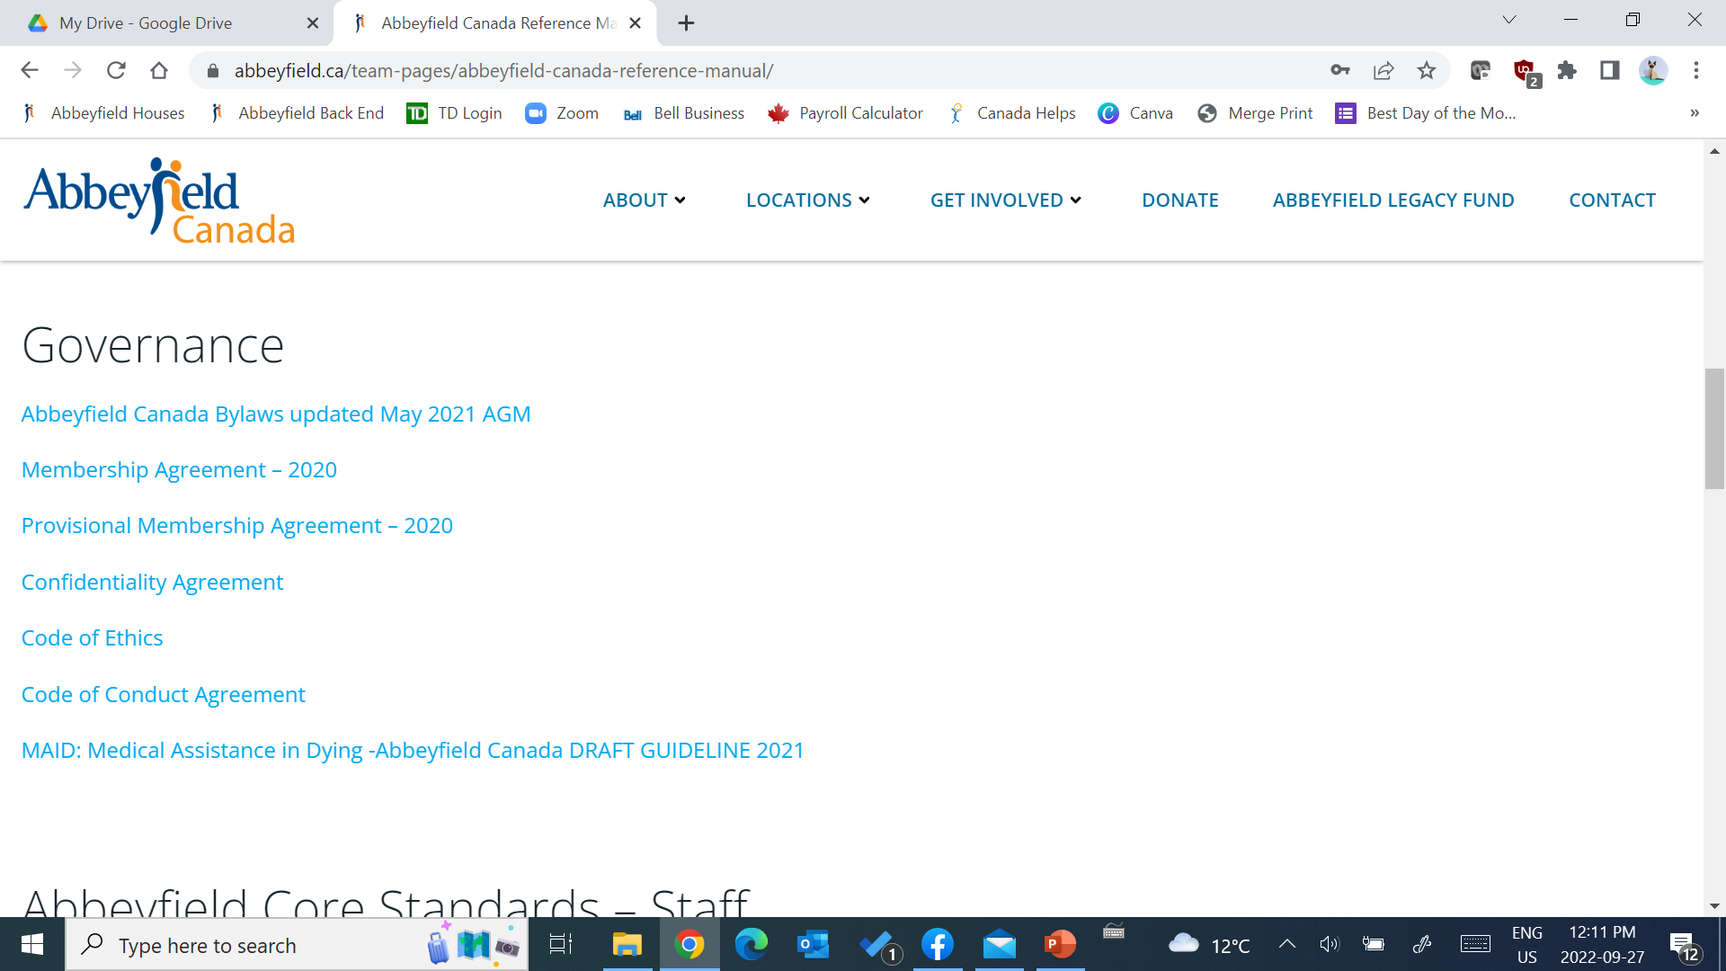

Slide 8
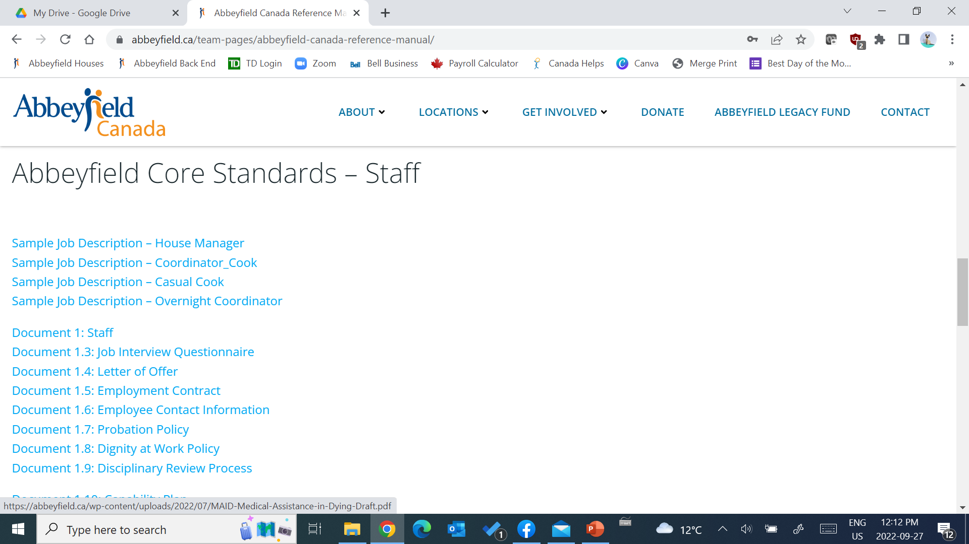

Slide 9
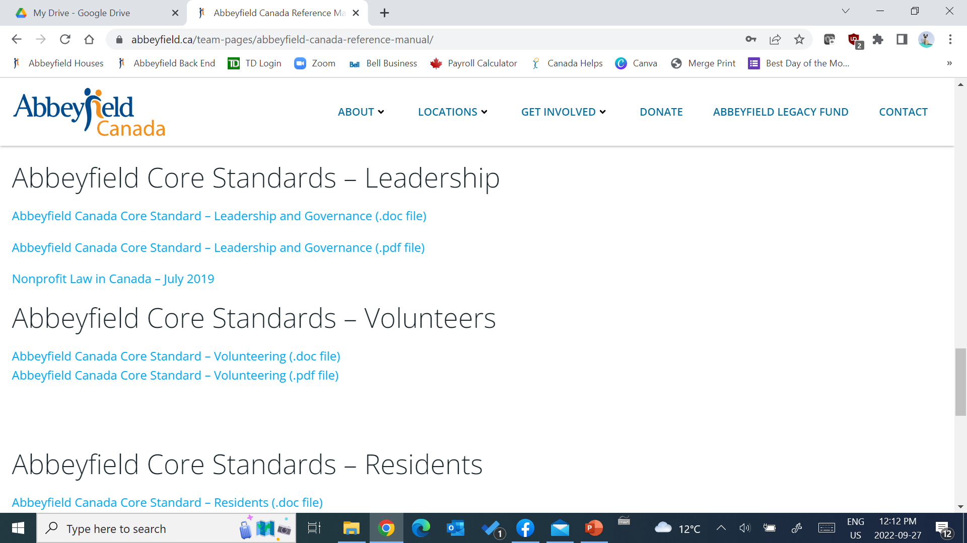

Slide 10
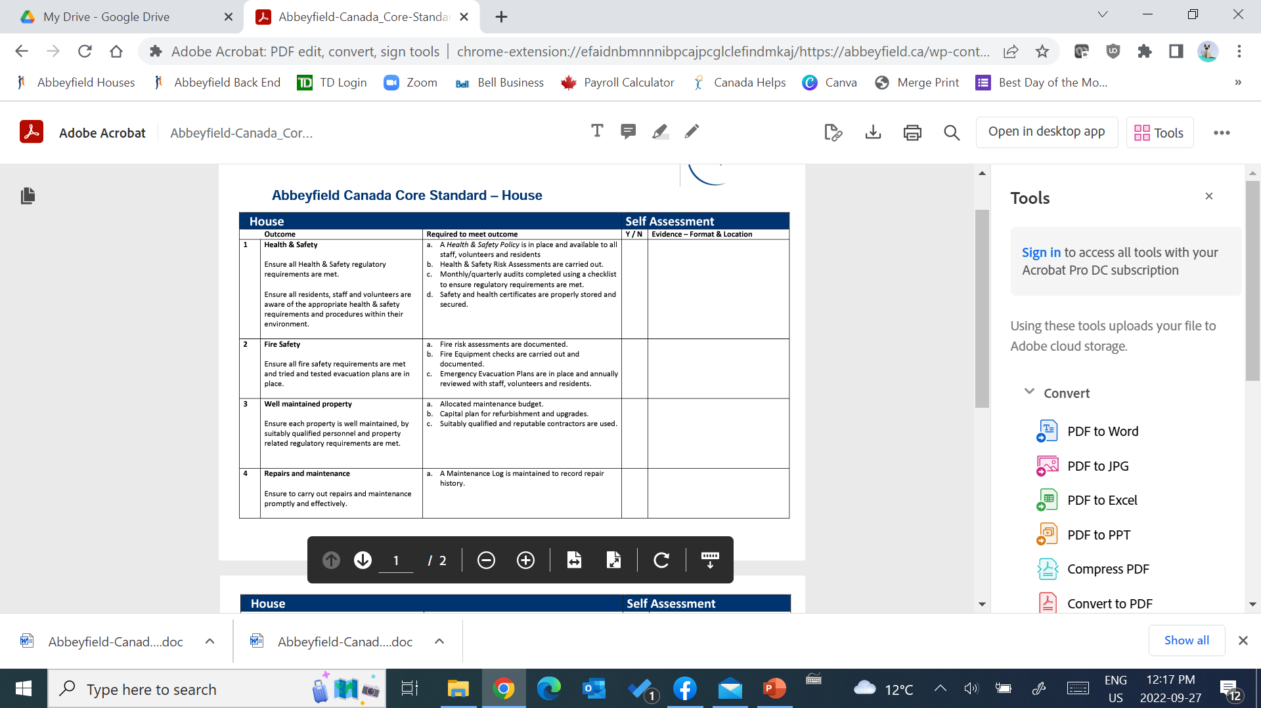

Slide 11
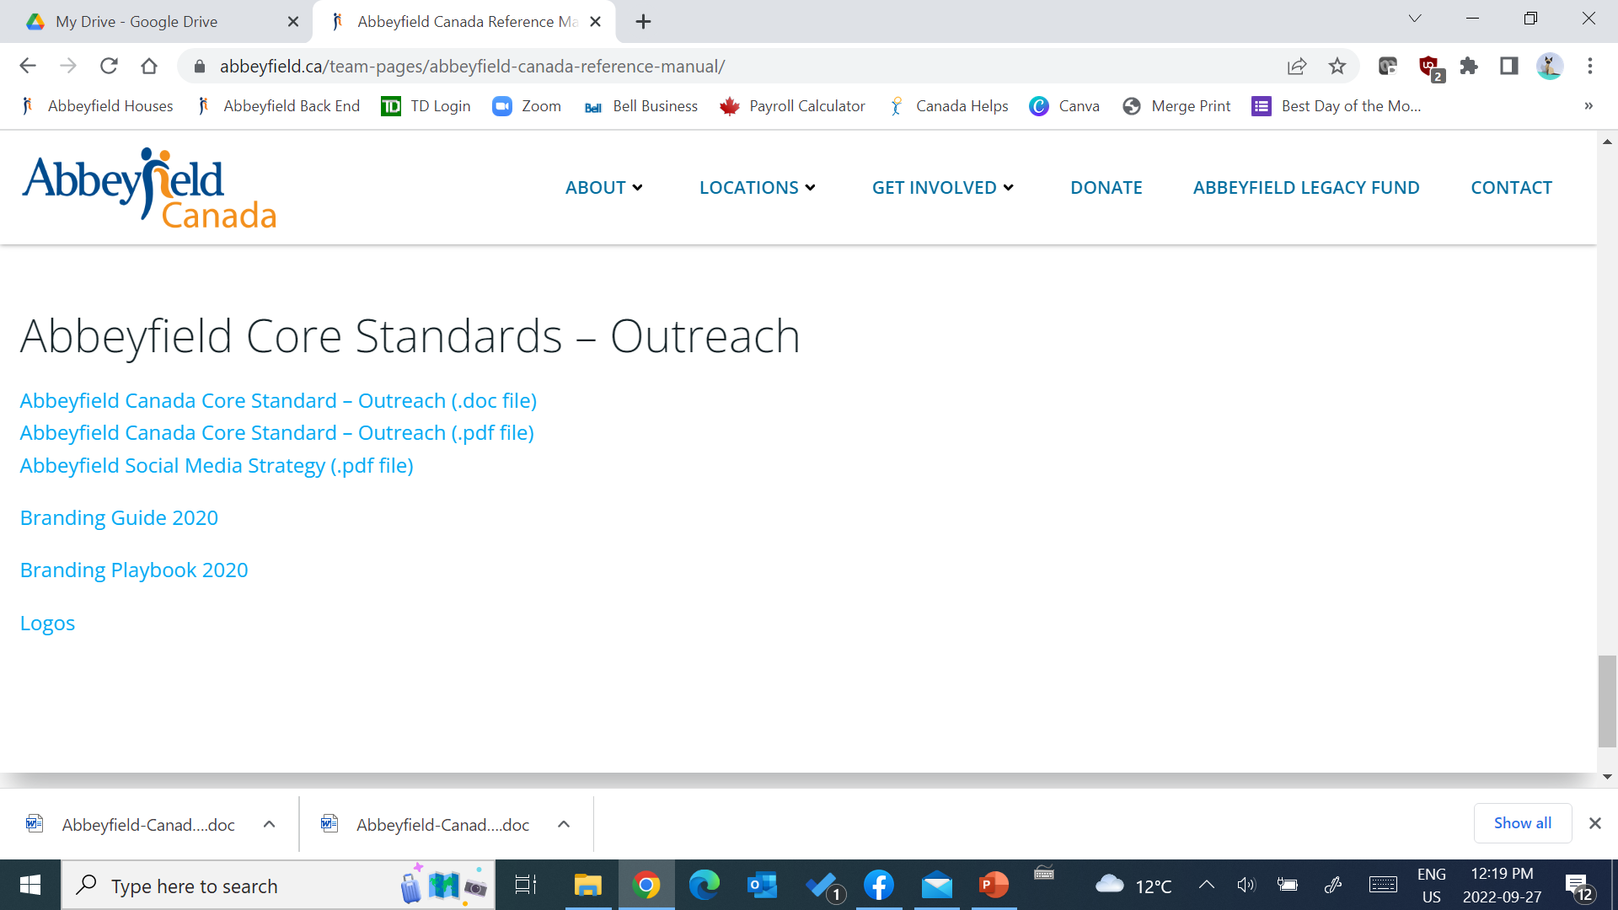

Slide 12
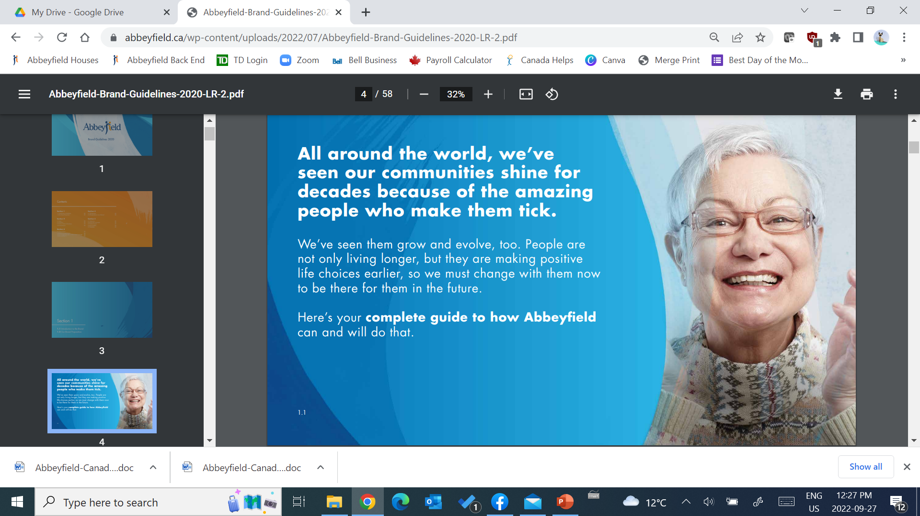

Slide 13
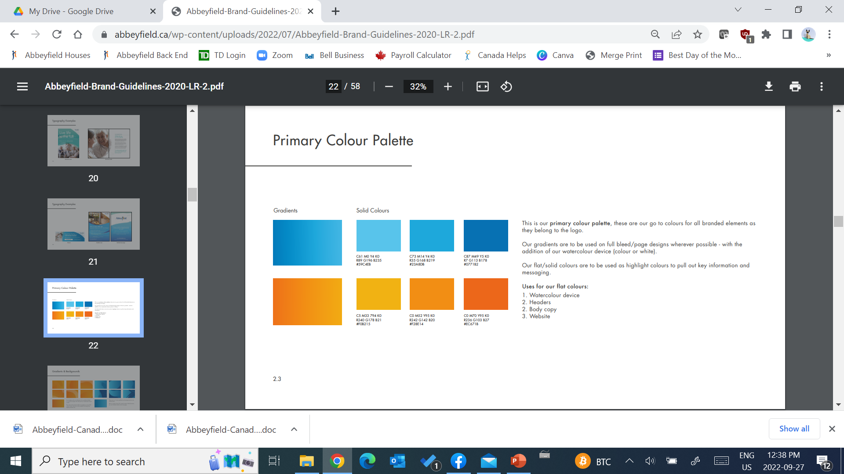

Slide 14

CLUB HOUSE October 15
You are invited to the
Saturday, October 15
Club House Zoom Event
Our host, Andrea Geary, will lead your conversation and ideas about Marketing for Abbeyfield Houses in Canada.
Email Andrea to share any ideas or questions you want to make sure we cover at!
Andrea.Geary@abbeyfield.ca

Slide 15

Scarecrow Challenge!

